Slide 1
Friends of Kansas Libraries- FoKL First Friday with Friends
Lacie Griffin- Collection Development Manager
Johnson County Library

Slide 2

2026 Emmy Award WINNER!
What surprised you the most from seeing the stories of the librarians in the film?
Why do you think that librarians have wound up on the frontlines of these heated political discussions about reading and intellectual freedom?

Slide 3
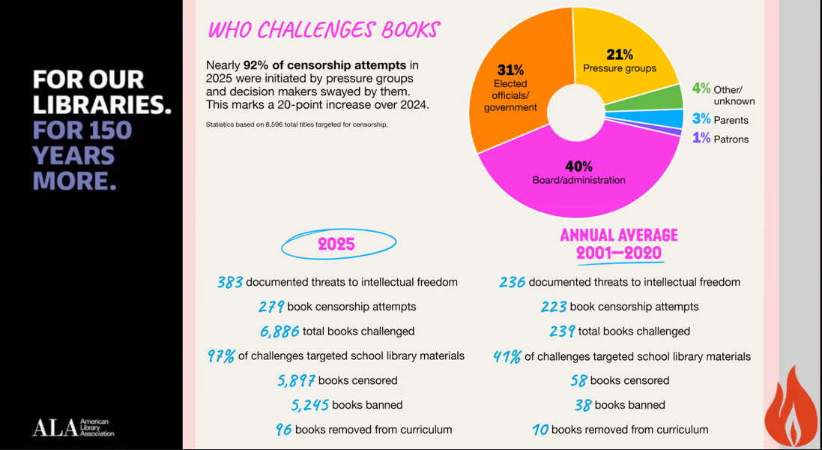

Slide 4
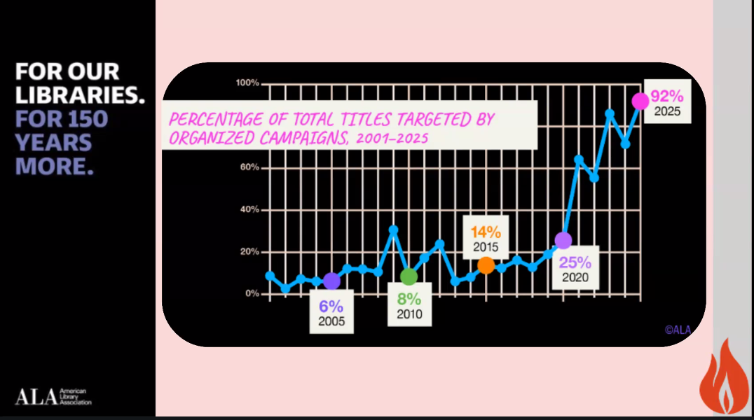

Slide 5


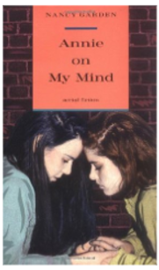
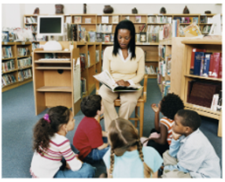

Case v. Unified School Dist. No. 233, 895 S. Supp. 1463 (D. Kan. 1995)
USD 233 = Olathe School District, Olathe KS
Little v. Llano County (Texas, Louisiana, Mississippi) (2025) (5th circuit)
Arkansas Act 372 (2023)
Fayetteville Public Library v. Murray (2026) (8^{h} circuit)

Slide 6

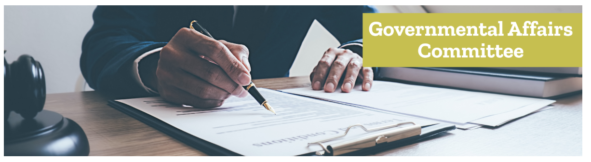

Kansas Library Association - Intellectual Freedom Committee
Kansas Library Association - Governmental Affairs Committee

Slide 7
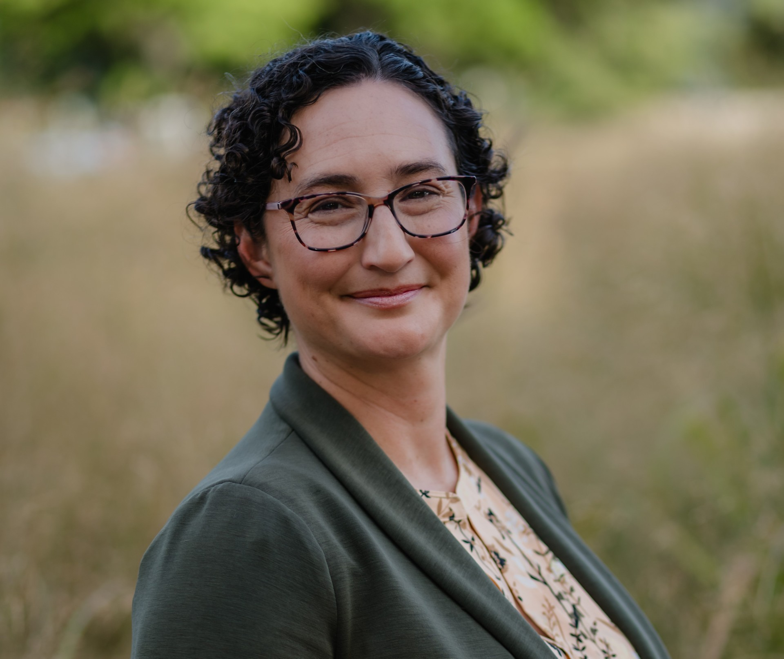


Thanks for joining us today!
griffinl@jocolibrary.org

Slide 8
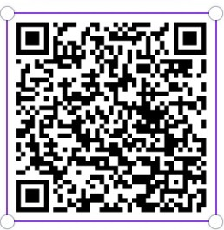


Thank you for coming!
Please scan the QR code to fill out a Law for Librarians Training Evaluation

